Slide 1
Chapter 6
Encoding and Modulation
Digital – digital conversion
Analog – digital conversion
Digital – analog conversion
Analog – analog conversion

Slide 2
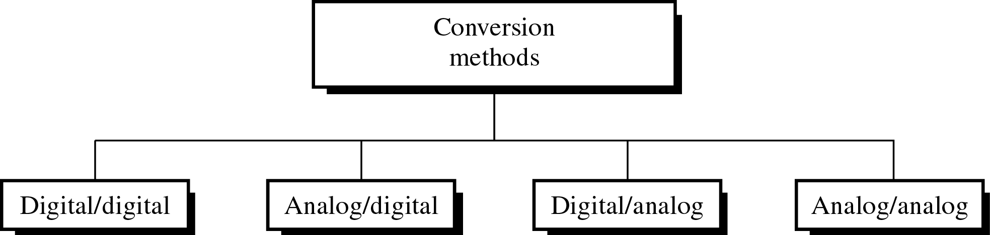
Different Conversion Schemes
当我们将数据由一地传送到另一地时，必须将其转换为信号！
  数字传输系统：信息以数字信号传输；
  模拟传输系统：信息以模拟信号传输。

Slide 3
Digital – digital conversion
Unipolar Encoding
Polar Encoding
Bipolar Encoding

Slide 4
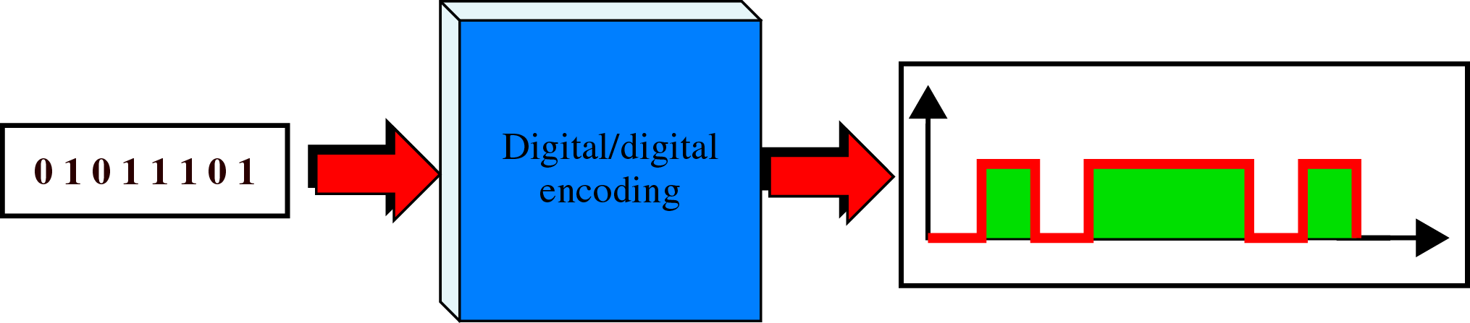
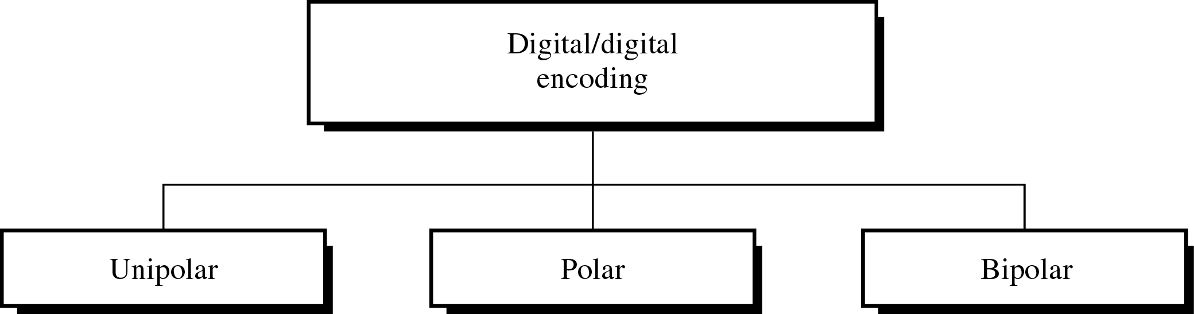
Digital to Digital Encoding and Types
数字－数字编码：用数字信号来表示数字信息。

Slide 5

Note:
Unipolar encoding uses only one voltage level.

Slide 6
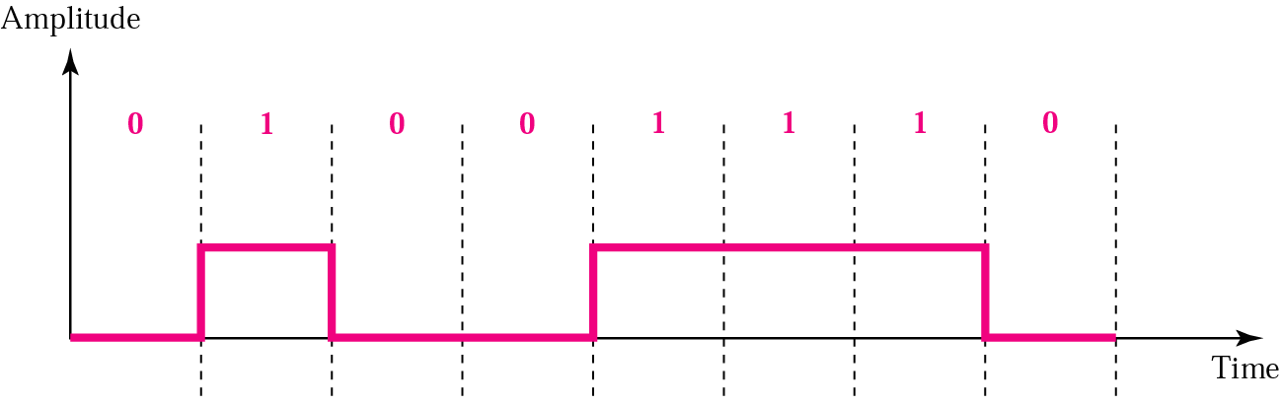
Unipolar Encoding
脉冲的极性：脉冲电压的正负。
单极性编码：只使用一极电压。
  优点：简单、实现廉价；
  缺点：需要解决直流分量和同步的问题。

Slide 7
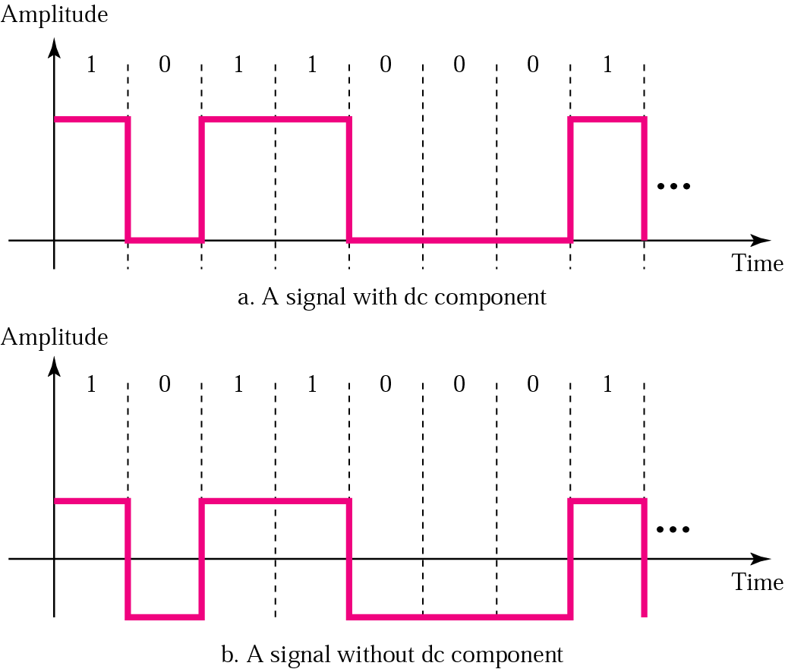
DC component（直流分量）

Slide 8
Note:
单极性信号的平均振幅不是零就产生了直流分量；当一个信号含有直流分量时，它就不能由没有处理直流分量能力的传输介质传输。

Slide 9
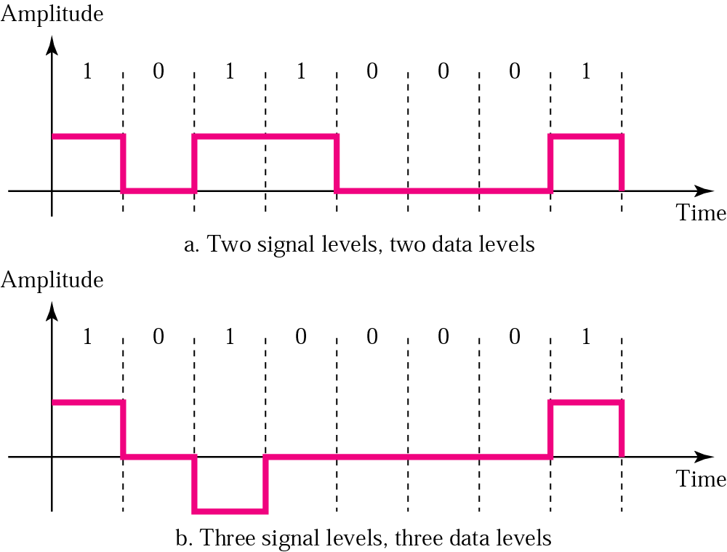
Signal level versus data level

Slide 10
Example 1
A signal has two data levels with a pulse duration of 1 ms. We calculate the pulse rate and bit rate as follows:
Pulse Rate = 1/ 10⁻³= 1000 pulses/s
Bit Rate = Pulse Rate x log₂ L = 1000 x log₂ 2 = 1000 bps

Slide 11
Example 2
A signal has four data levels with a pulse duration of 1 ms. We calculate the pulse rate and bit rate as follows:
Pulse Rate = = 1000 pulses/s
Bit Rate = PulseRate x log₂ L = 1000 x log₂ 4 = 2000 bps

Slide 12
Lack of synchronization
发送方与接收方时钟缺乏同步会使信号时序发生扭曲！
在单极性编码中，当数据流中包含一长串连1或连0时，就会产生同步问题。
  数字编码方法采用电压的改变来指示比特位的改变。
  在单极性编码中出现一连串相同的比特时，就没有信号的变化来指明下一个比特的开始，接收方就只能依赖定时器判断比特的开始和结束。

Slide 13
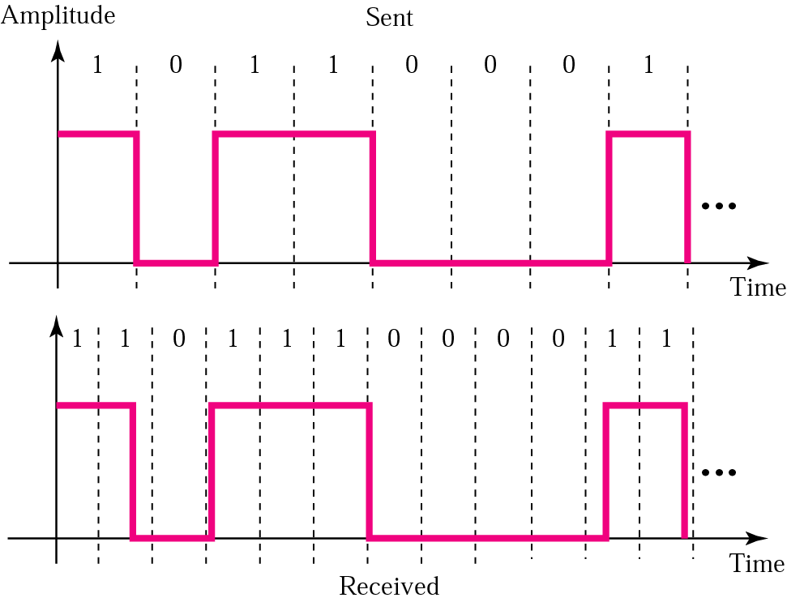
Lack of synchronization

Slide 14
Example 3
In a digital transmission, the receiver clock is 0.1 percent faster than the sender clock. How many extra bits per second does the receiver receive if the data rate is 1 Kbps? How many if the data rate is 1 Mbps?
Solution
At 1 Kbps:
1000 bits sent ➔1001 bits received➔1 extra bps
At 1 Mbps:
1,000,000 bits sent ➔1,001,000 bits received➔1000 extra bps

Slide 15
Note:
Polar encoding uses two voltage levels (positive and negative).

Slide 16
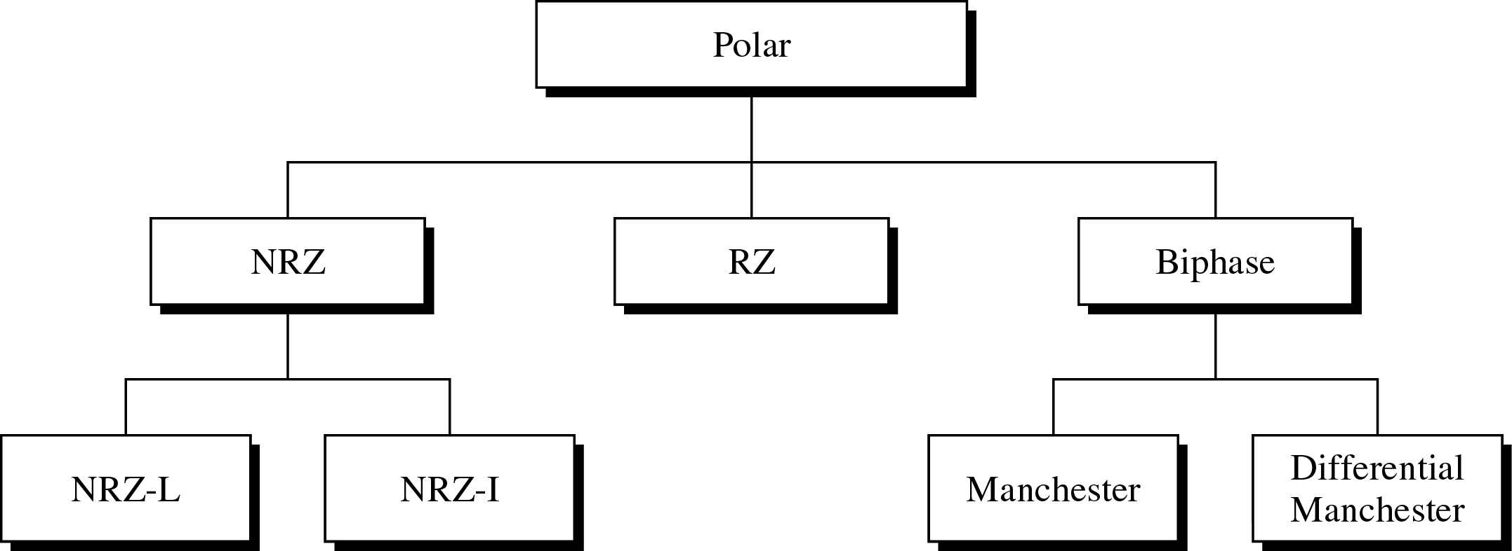
Types of Polar Encoding
极化编码：采用两个电压值的振幅，一正一负。
  优点：线路中的平均电压值下降了，并减轻了单极性编码中的直流分量问题。

Slide 17
Note:
In NRZ-L（非归零码） the level of the signal is dependent upon the state of the bit.
In NRZ-I （非归零反相码） the signal is inverted if a 1 is encountered.

Slide 18
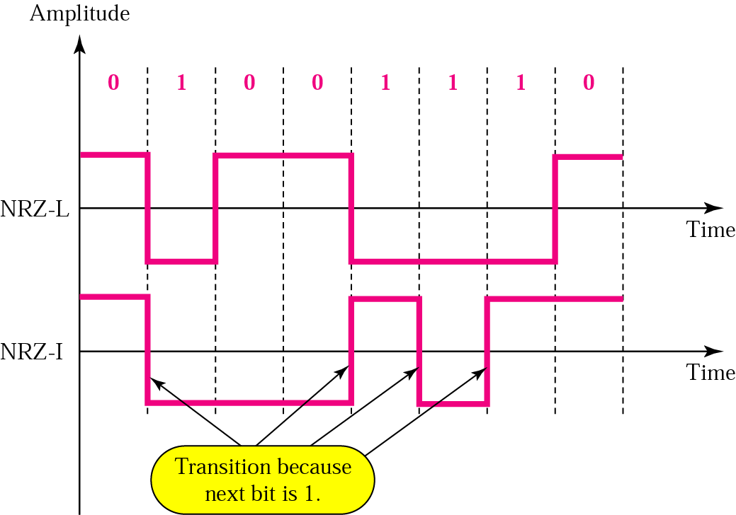
NRZ-L and NRZ-I Encoding
缺点：仍然会遇到直流分量问题。
  NRZ-I比NRZ-L好些，仅在遇到连续的0时有直流分量问题。

Slide 19
RZ Encoding
当出现连续的1或0时，接收端就会失去同步而使时序发生扭曲！
  一种保证同步的方法是在一条独立的信道上发送单独的定时信号，但此法不经济且容易出错；
  另一个更好的方案是让编码信号本身携带同步信息：
    NRZ-L只对连1信号实现了这个目标；
    为了在每个比特都有信号变化，可以使用归零码（RZ）或曼彻斯特码、差分曼彻斯特码。

Slide 20
Note:
RZ（归零码） uses three voltage levels： positive 、negative 、zero；
And the signal transition doesn’t happen between the bits，but in the bits.

Slide 21
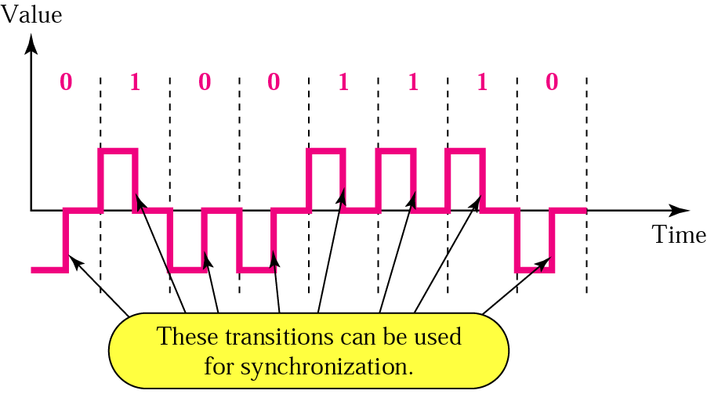
RZ Encoding
缺点：需要两次信号变化来编码1比特，从而增加了占用的带宽。

Slide 22
Note:
A good encoded digital signal must contain a provision for synchronization.

Slide 23
Manchester and Diff. Manchester Encoding
对同步问题最好的解决方案是使用双相位编码，信号在每比特间隔的中间发生改变但并不归零，这种中间跳变使同步变得可能！
  双相位编码通过两种方式实现：曼彻斯特编码和差分曼彻斯特编码。

Slide 24
Note:
In Manchester encoding, the transition at the middle of the bit is used for both synchronization and bit representation.

Slide 25
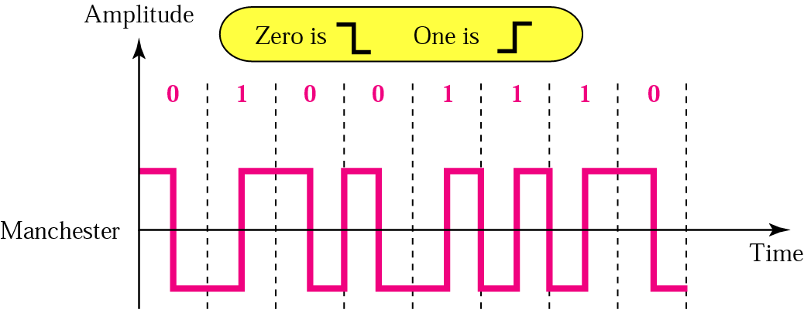
Manchester Encoding
曼彻斯特编码：在每个比特间隔的中间引入跳变，一个负电平到正电平的跳变代表比特1，一个正电平到负电平的跳变代表比特0。
  优点：中间跳变实现了同步作用，而仅需要两种电平振幅。

Slide 26
Note:
In differential Manchester encoding, the transition at the middle of the bit is used only for synchronization.
The bit representation is defined by the inversion or noninversion at the beginning of the bit.

Slide 27
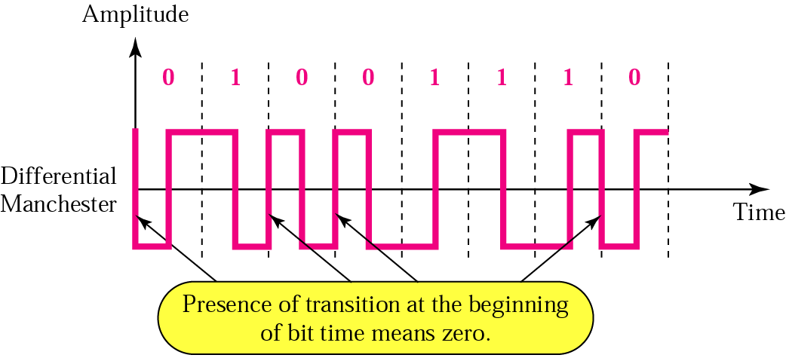
Diff. Manchester Encoding
差分曼彻斯特编码：在每个比特间隔的中间引入跳变，比特间隔的前沿无跳变代表比特1，比特间隔的前沿有跳变代表比特0。
  优点：中间跳变实现了同步作用，而仅需要两种电平振幅。

Slide 28
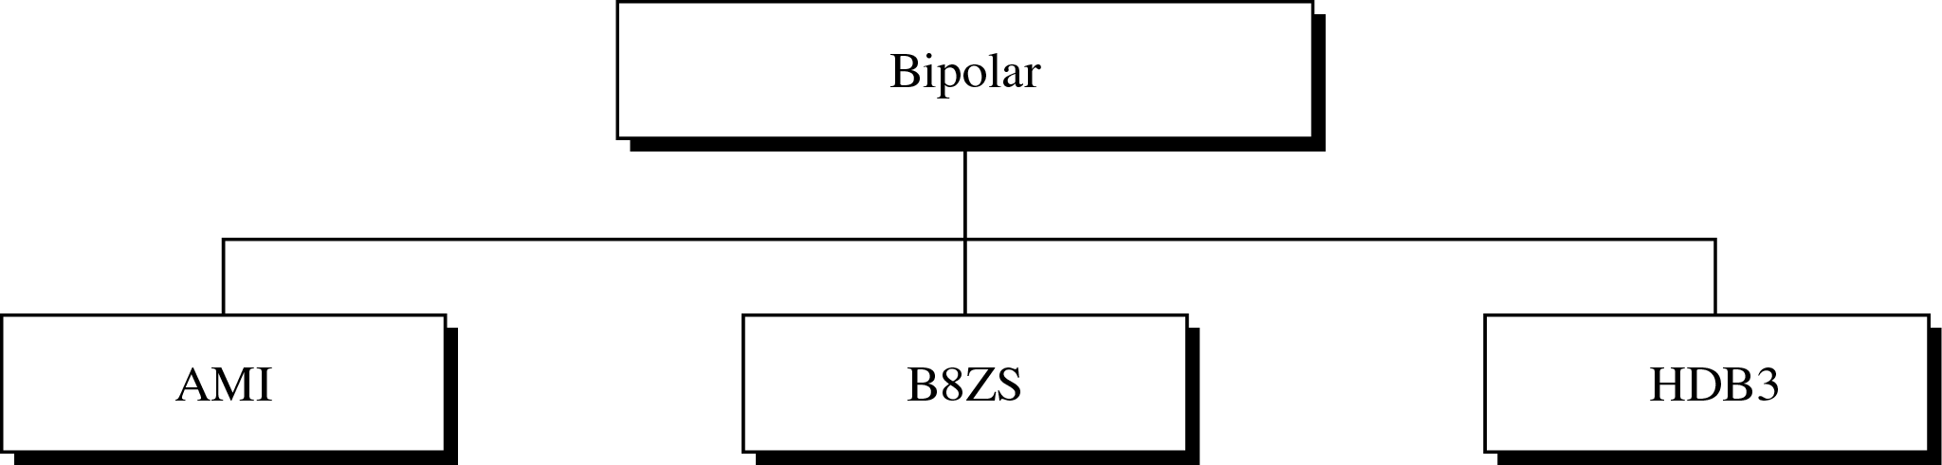
Types of Bipolar Encoding
双极性编码：使用三个电平值，正电平、负电平和零，电平值零代表比特0，正负电平交替代表比特1。
  三种广泛应用的双极性编码：传号交替反转(AMI)、双极性8连0替换(B8ZS)、3阶高密度双极性(HDB3)。

Slide 29
Note:
In bipolar encoding, we use three levels: positive, zero, and negative.

Slide 30
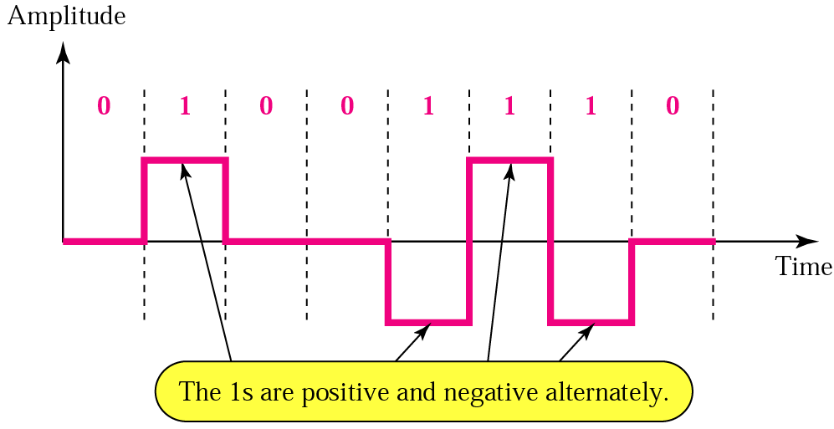
Bipolar AMI Encoding
双极性传号交替反转AMI编码：零电平代表比特0，交替的正负电平跳变代表比特1。
  优点：直流分量为零、对一连串的比特1可以同步。
  伪三元：AMI的一个变体，由二进制0在正负电压之间交替变换。

Slide 31
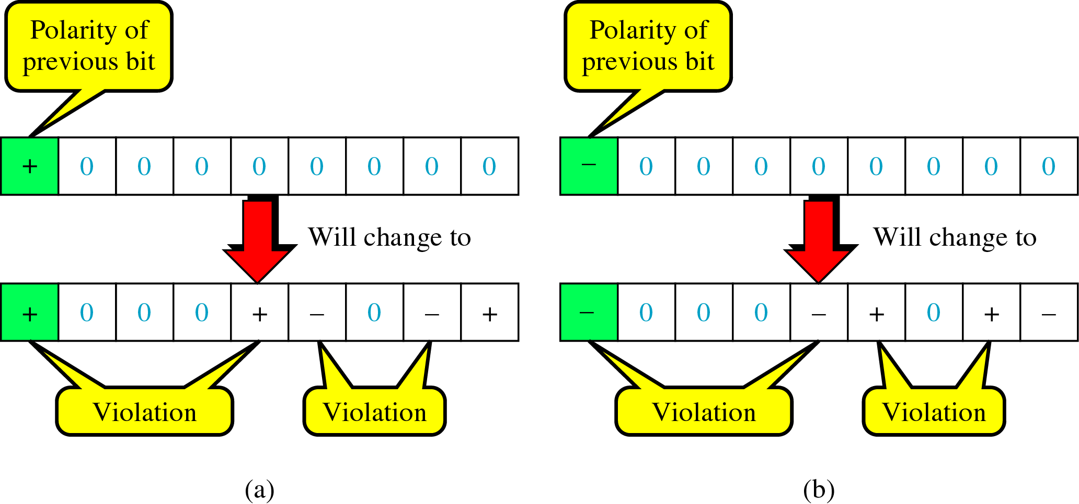
B8ZS Encoding
双极性8连0替换B8ZS编码：零电平代表比特0，交替的正负电平跳变代表比特1；当遇到连续的8个零时，若前导1由正电平表示则将8个0编码为“000正负0负正”，若前导1由负电平表示则将8个0编码为“000负正0正负” 。

Slide 32
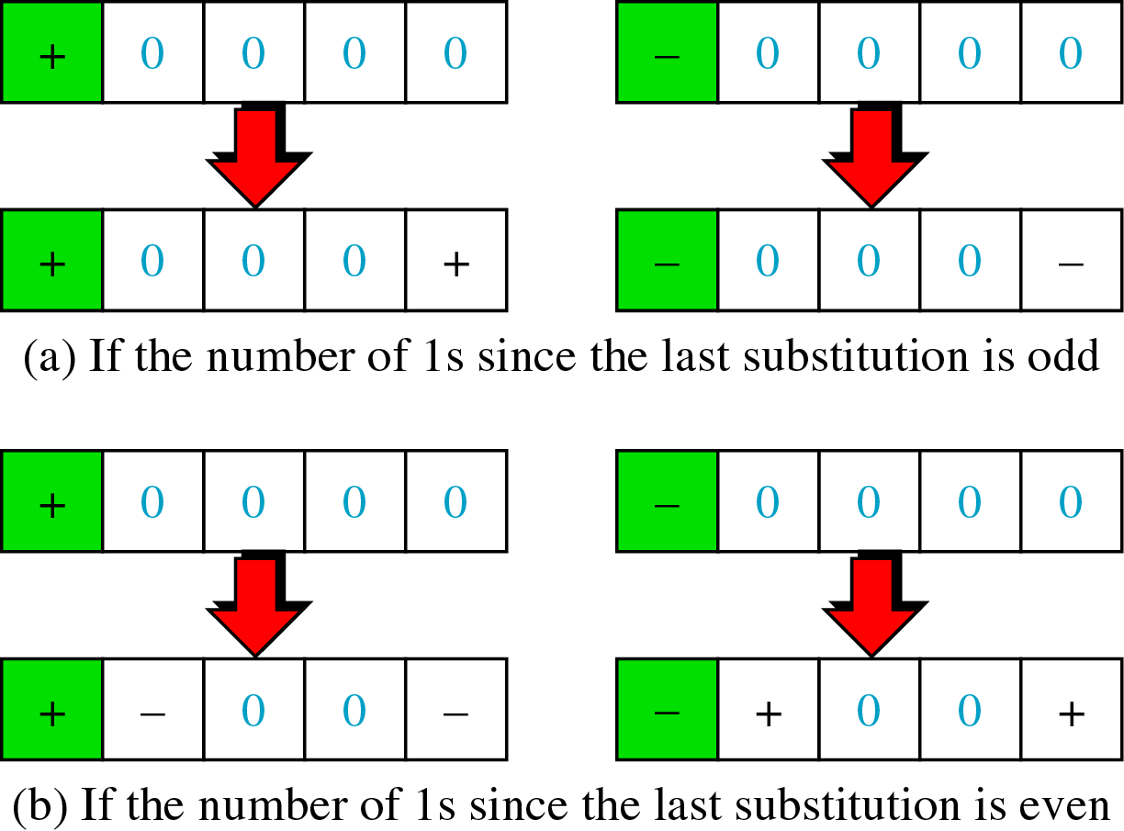
HDB3 Encoding
3阶高密度双极性HDB3编码：零电平代表比特0，交替的正负电平跳变代表比特1 ；当遇到连续的4个零时，则根据前导1的极性和自上一次替换后传输的1比特数，以4种方式改变对应的比特模式。

Slide 33
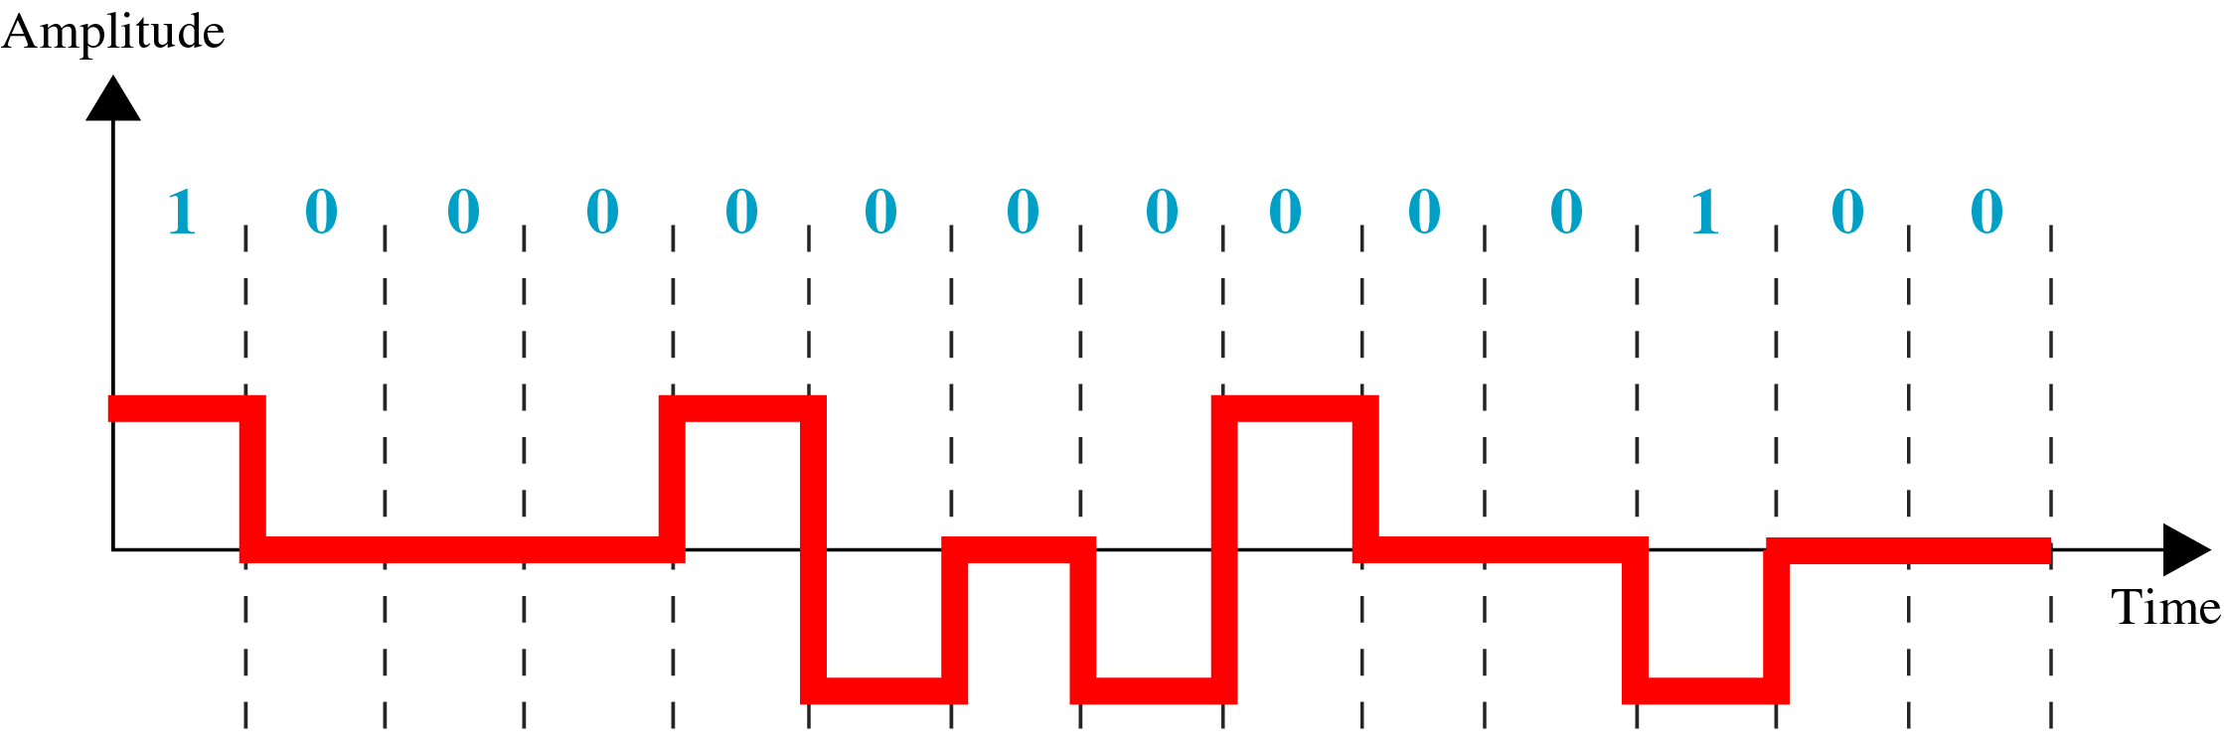
Example 4
采用B8ZS对比特流10000000000100进行编码，假设第一个1的极性为正?
Solution

Slide 34
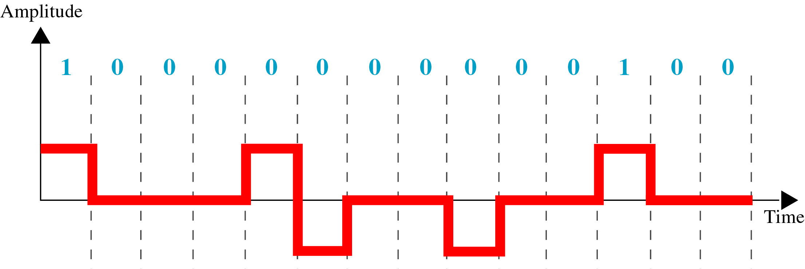
Example 5
采用HDB3对比特流10000000000100进行编码，假设到目前1比特的个数是奇数，并且第一个1的极性为正?
Solution

Slide 35
Analog – digital conversion
Pulse amplitude modulation (PAM)
Pulse code modulation (PCM)
Sampling rate

Slide 36
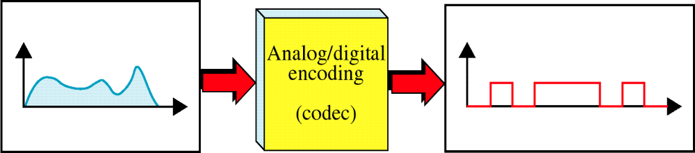
Analog to Digital Encoding
模拟－数字编码：用数字信号来表示模拟信息。
  例如：长距离传输语音信号时，由于数字信号易于较少噪音，因而需要将模拟信号数字化。
  这就要求减少模拟报文中潜在的无穷个数值，使模拟量可以在最小的失真下用数字流来表示，数字流可以采用上节提到的任何数字信号。

Slide 37
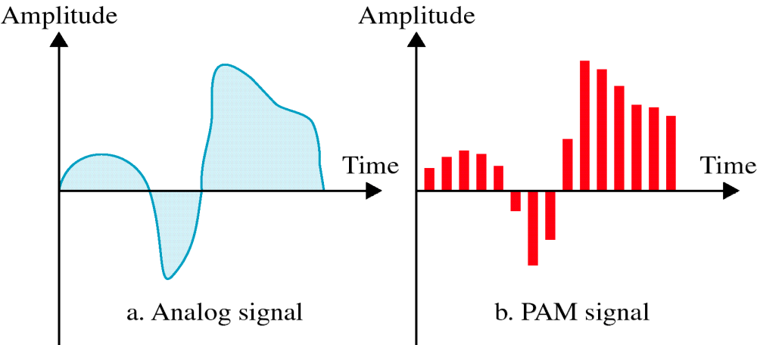
脉冲振幅调制 PAM
脉冲振幅调制PAM：是模拟－数字技术的第一步，也是脉码调制技术PCM的基础，通过收集模拟信号，对其进行采样，然后根据采样结果产生一系列脉冲。
  采样：每隔相等的时间间隔就测量一次信号幅值。

Slide 38
Note:
Pulse amplitude modulation has some applications, but it is not used by itself in data communication. However, it is the first step in another very popular conversion method called pulse code modulation.

Slide 39
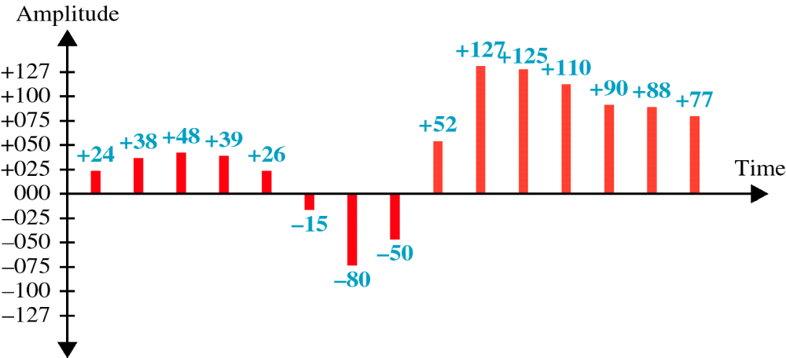
Quantized PAM Signal
尽管PAM将原始信号波形转换成了一系列脉冲，但这些脉冲的取值仍然可以是任意振幅值，并不实用；因此PCM首先要对PAM的脉冲进行量化。
  量化：对采样结果赋予一个特定范围内的整数值。

Slide 40
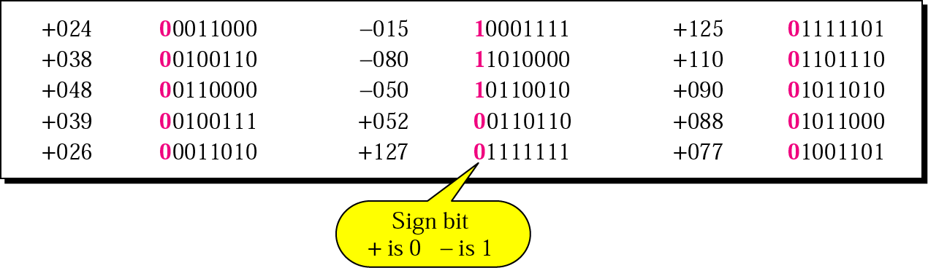
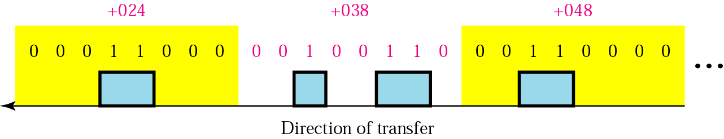
Quantizing Using Sign and Magnitude
上图是一种将符号和数值赋予量化信号的简单方法。
下图是原始信号经过PCM转换成单极性编码的结果。

Slide 41
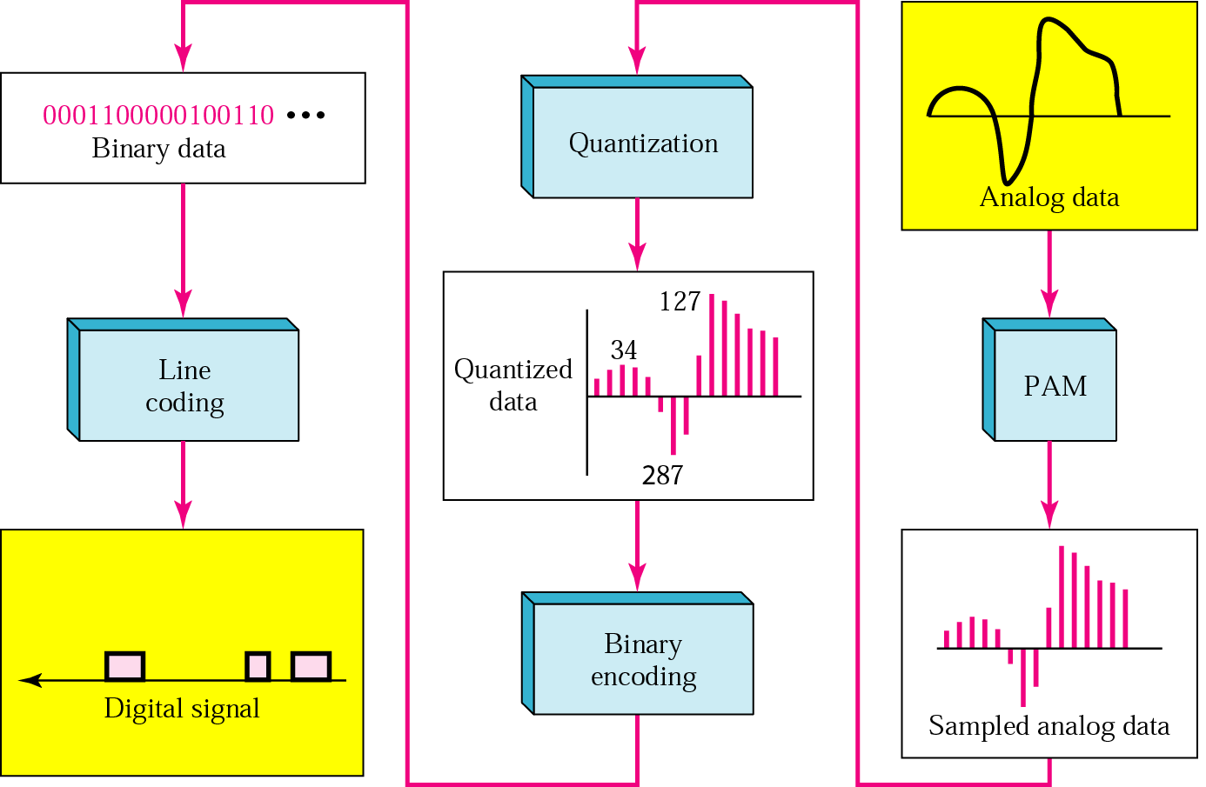
From Analog to PCM

Slide 42
Note:
According to the Nyquist theorem, the sampling rate must be at least 2 times the highest frequency.

Slide 43
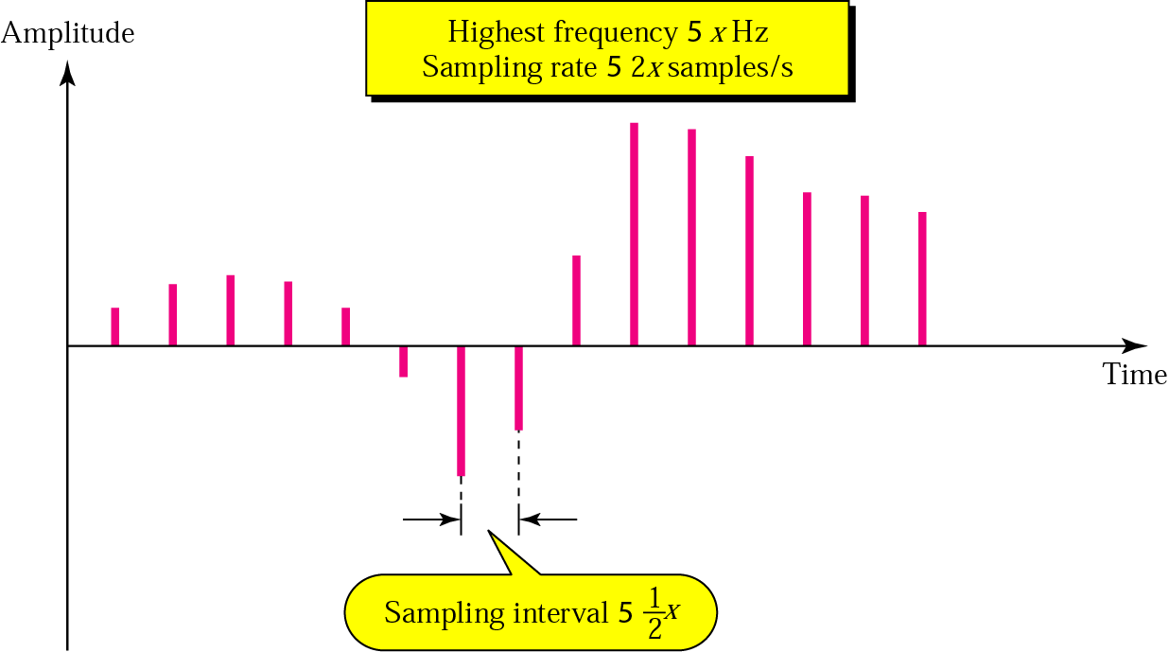
Nyquist Theorem
一个两倍于x Hz的采样频率意味着必须每0.5xs对信号进行一次采样。

Slide 44
Example 6
What sampling rate is needed for a signal with a bandwidth of 10,000 Hz (1000 to 11,000 Hz)?
Solution
The sampling rate must be twice the highest frequency in the signal:
Sampling rate = 2 x (11,000) = 22,000 samples/s

Slide 45
Example 7
A signal is sampled. Each sample requires at least 12 levels of precision (+0 to +5 and -0 to -5). How many bits should be sent for each sample?
Solution
We need 4 bits; 1 bit for the sign and 3 bits for the value. A 3-bit value can represent 2³ = 8 levels (000 to 111), which is more than what we need. A 2-bit value is not enough since 2² = 4. A 4-bit value is too much because 2⁴ = 16.

Slide 46
Example 8
We want to digitize the human voice. What is the bit rate, assuming 8 bits per sample?
Solution
The human voice normally contains frequencies from 0 to 4000 Hz.
Sampling rate = 4000 x 2 = 8000 samples/s
Bit rate = sampling rate × number of bits per sample
= 8000 x 8 = 64,000 bps = 64 Kbps

Slide 47
Note:
Note that we can always change a band-pass signal to a low-pass signal before sampling. In this case, the sampling rate is twice the bandwidth.

Slide 48
Digital – analog conversion
Digital-to-Analog Conversion
Amplitude Shift Keying (ASK)
Frequency Shift Keying (FSK)
Phase Shift Keying (PSK)
Quadrature Amplitude Modulation
Bit/Baud Comparison

Slide 49
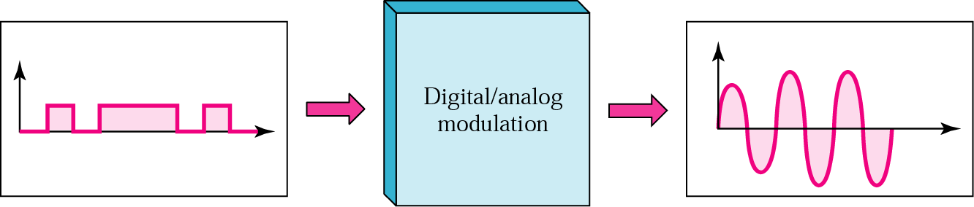
Digital-to-Analog Conversion
数字－模拟调制是基于以数字信号（0和1）表示的信息来改变模拟信号特征的过程。
载波信号(载波频率)：由发送设备产生的、用来作为基波去承载信息信号的一个高频信号。
调制(移动键控)：通过改变载波信号的一个或多个特性将数字信息调制到载波信号上的过程。
调制信号：输入的用来改变载波信号特性的信息信号。

Slide 50
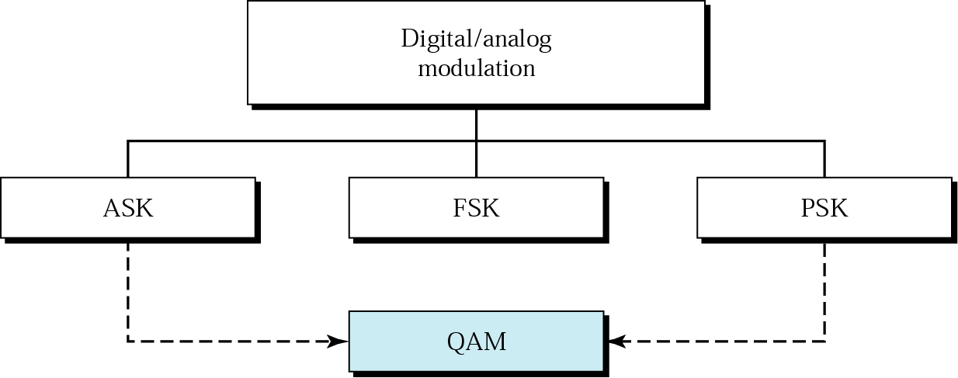
Digital-to-Analog Conversion
数字－模拟调制可以通过反复改变简单电气信号的三个特性(振幅、频率、相位)中的一个来表示数字数据。

Slide 51
Note:
Bit rate is the number of bits per second. Baud rate is the number of signal units per second. Baud rate is less than or equal to the bit rate.

Slide 52
Example 9
An analog signal carries 4 bits in each signal unit. If 1000 signal units are sent per second, find the baud rate and the bit rate
Solution
Baud rate = 1000 bauds per second (baud/s)
Bit rate = 1000 x 4 = 4000 bps

Slide 53
Example 10
The bit rate of a signal is 3000. If each signal unit carries 6 bits, what is the baud rate?
Solution
Baud rate = 3000 / 6 = 500 baud/s

Slide 54
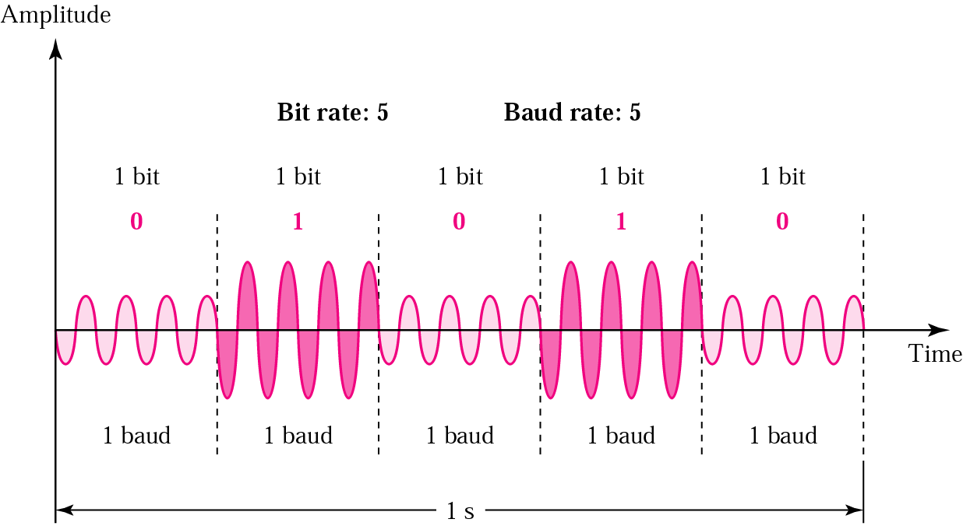
幅移键控 ASK
幅移键控ASK技术通过改变载波信号的强度来表示二进制0或1，用不同的电压来分别代表0和1。

Slide 55
幅移键控 ASK
缺点：幅移键控ASK技术受噪声影响很大，噪声等外来电压与信号一起改变了振幅。
开关键控OOK：某一比特值用没有电压来表示，好处是传输信息所需的能量下降了。

Slide 56
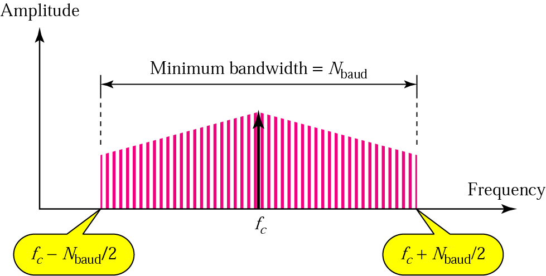
Bandwidth for ASK
当我们分解一个ASK调制的信号时，会得到一个由许多简单频率组成的谱系，但有意义的频率在f_{c}-0.5N_{baud}与f_{c}＋0.5N_{baud}之间，中间是载波频率f_{c}。
采用ASK技术所需的带宽BW用以下公式计算：
BW=(1+d)×N_{baud}
  d是和线路状况有关的一个因子(最小值为0)。

Slide 57
Example 11
Find the minimum bandwidth for an ASK signal transmitting at 2000 bps. The transmission mode is half-duplex.
Solution
In ASK the baud rate and bit rate are the same. The baud rate is therefore 2000. An ASK signal requires a minimum bandwidth equal to its baud rate. Therefore, the minimum bandwidth is 2000 Hz.

Slide 58
Example 12
Given a bandwidth of 5000 Hz for an ASK signal, what are the baud rate and bit rate?
Solution
In ASK the baud rate is the same as the bandwidth, which means the baud rate is 5000. But because the baud rate and the bit rate are also the same for ASK, the bit rate is 5000 bps.

Slide 59
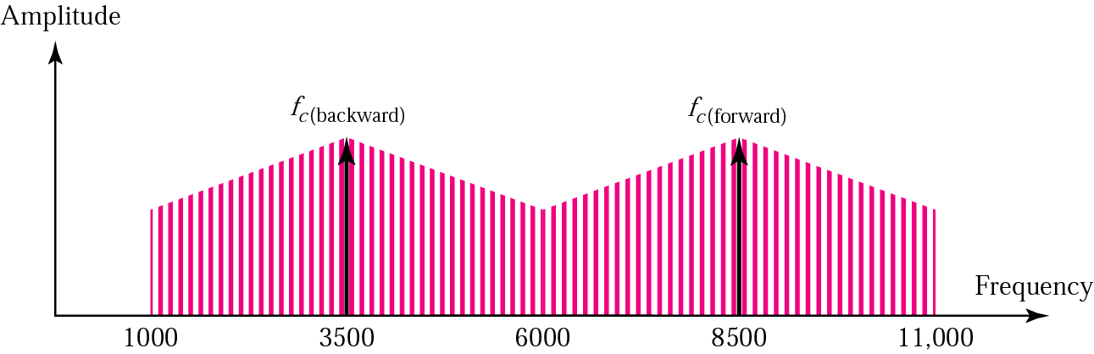
Example 13
Given a bandwidth of 10,000 Hz (1000 to 11,000 Hz), draw the full-duplex ASK diagram of the system. Find the carriers and the bandwidths in each direction. Assume there is no gap between the bands in the two directions.
Solution
For full-duplex ASK, the bandwidth for each direction is
BW = 10000 / 2 = 5000 Hz
The carrier frequencies can be chosen at the middle of each band (see Fig. 5.5).
fc (forward) = 1000 + 5000/2 = 3500 Hz
fc (backward) = 11000 – 5000/2 = 8500 Hz

Slide 60
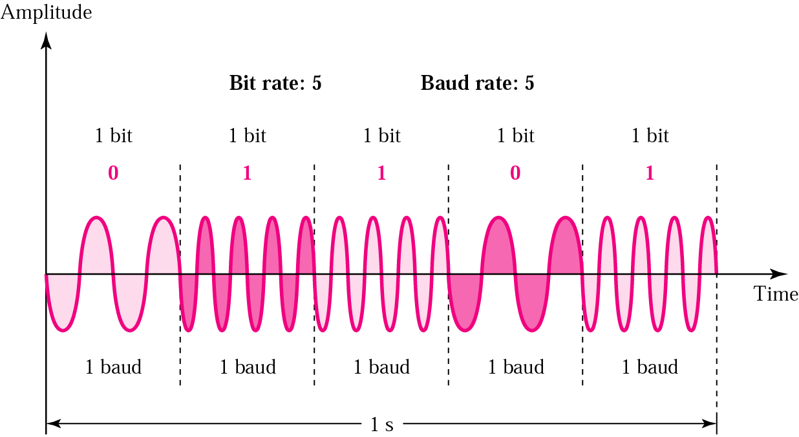
频移键控 FSK
频移键控FSK通过改变信号的频率来表示二进制0或1。
优点：避免了ASK技术中的大多数噪声问题，能忽略电压的尖峰信号。
缺点：限制因素是载波的物理容量。

Slide 61
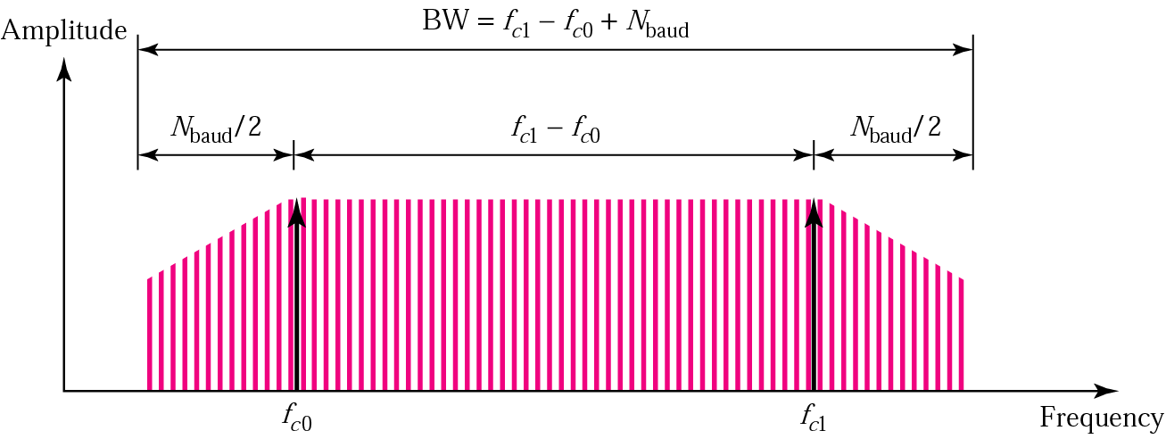
Bandwidth for FSK
可以将FSK看作是中心频率分别为f_{c0} 和_{fc1} 的两个ASK频谱的组合。
FSK传输要求的带宽等于信号波特率加上频移值（两个载波频率的差值）：
BW= (f_{c1 –}f_{c0} )＋N_{baud}

Slide 62
Example 14
Find the minimum bandwidth for an FSK signal transmitting at 2000 bps. Transmission is in half-duplex mode, and the carriers are separated by 3000 Hz.
Solution
For FSK
BW = baud rate + f_{c1} − f_{c0}
BW = bit rate + fc1 − fc0 = 2000 + 3000 = 5000 Hz

Slide 63
Example 15
Find the maximum bit rates for an FSK signal if the bandwidth of the medium is 12,000 Hz and the difference between the two carriers is 2000 Hz. Transmission is in full-duplex mode.
Solution
Because the transmission is full duplex, only 6000 Hz is allocated for each direction.
BW = baud rate + fc1 − fc0
Baud rate = BW − (fc1 − fc0 ) = 6000 − 2000 = 4000
But because the baud rate is the same as the bit rate, the bit rate is 4000 bps.

Slide 64
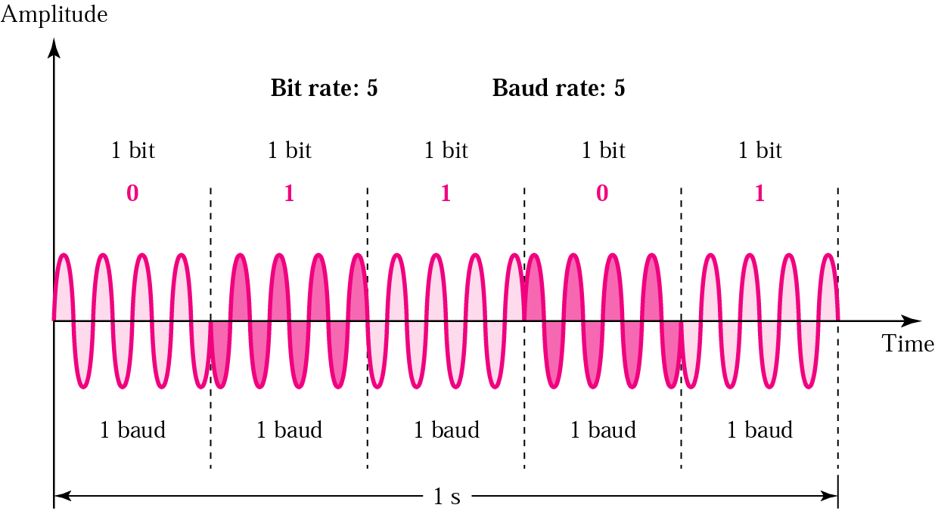
相移键控 PSK
相移键控PSK通过改变载波信号的相位来表示二进制0或1。

Slide 65
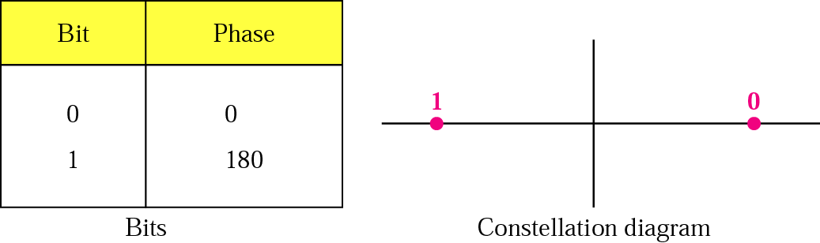
PSK Constellation
2-PSK(二相位PSK)：在调制中使用了两个不同的相位值(通常是0度和180度)
特点：不像ASK调制那样容易受噪声干扰，但像FSK一样受带宽限制，意味着接收方可以可靠的检测到更小的信号变化。

Slide 66
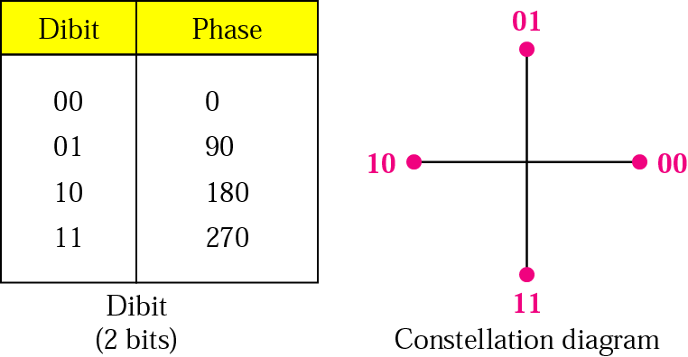
4-PSK
可以采用4种信号变化，每种相移代表两个比特。

Slide 67
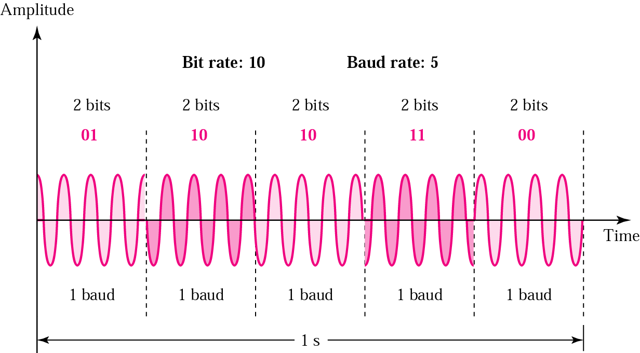
4-PSK Characteristics
使用4-PSK时可以得到两倍于2-PSK的传输速率。

Slide 68
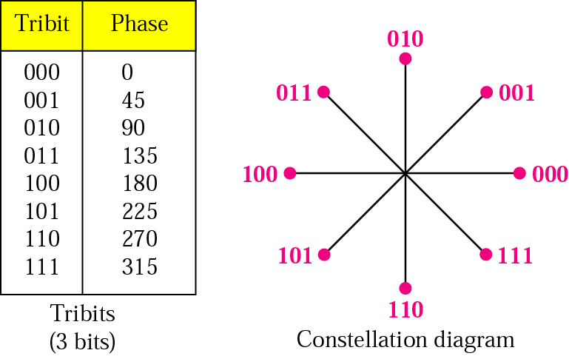
8-PSK Characteristics
可以采用8种信号变化，每种相移代表三个比特。
使用8-PSK时可以得到三倍于2-PSK的传输速率。

Slide 69
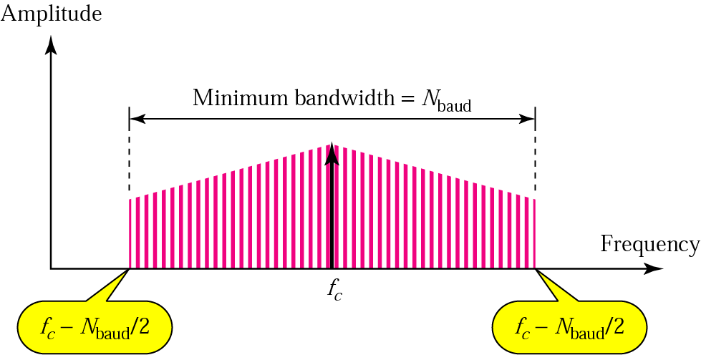
PSK Bandwidth
PSK传输要求的最小带宽与ASK调制所需的相等：
BW=(1+d)×N_{baud}
d是和线路状况有关的一个因子(最小值为0)。

Slide 70
Example 16
Find the bandwidth for a 4-PSK signal transmitting at 2000 bps. Transmission is in half-duplex mode.
Solution
For PSK the baud rate is the same as the bandwidth, which means the baud rate is 5000. But in 8-PSK the bit rate is 3 times the baud rate, so the bit rate is 15,000 bps.

Slide 71
Example 17
Given a bandwidth of 5000 Hz for an 8-PSK signal, what are the baud rate and bit rate?
Solution
For PSK the baud rate is the same as the bandwidth, which means the baud rate is 5000. But in 8-PSK the bit rate is 3 times the baud rate, so the bit rate is 15,000 bps.

Slide 72
Note:
Quadrature amplitude modulation is a combination of ASK and PSK so that a maximum contrast between each signal unit (bit, dibit, tribit, and so on) is achieved.

Slide 73
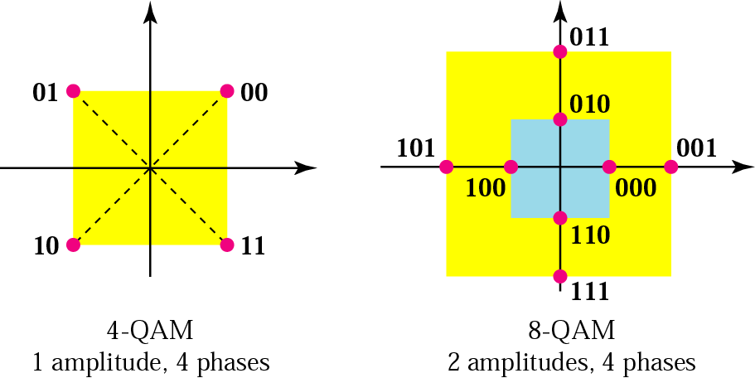
4-QAM and 8-QAM Constellations
由于振幅变化比相位变化更容易受噪声干扰，因此QAM系统中所使用的相位变化的数量总是比振幅变化的要多！

Slide 74
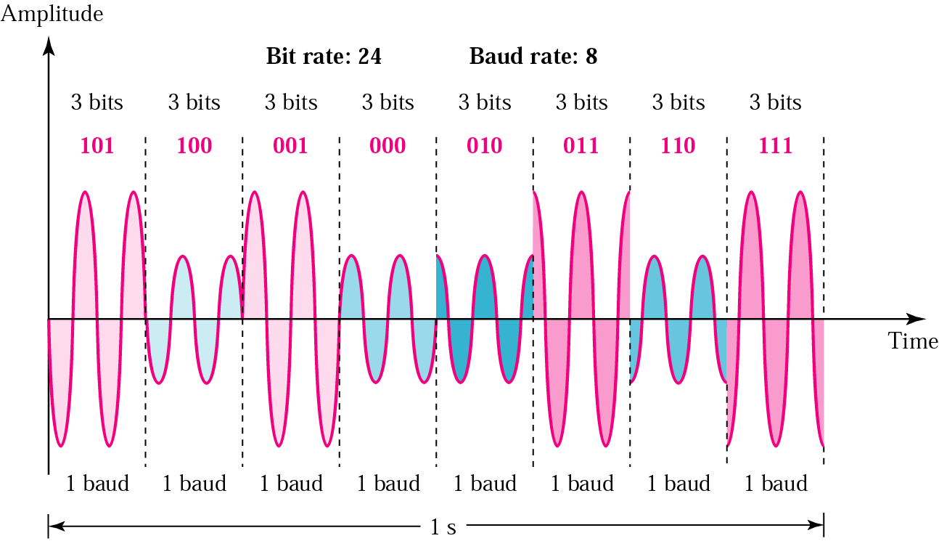
8-QAM Signal
8-QAM采用8种信号变化，每种信号代表三个比特。
使用8-QAM可以得到三倍于调制数率的数据传输速率。

Slide 75
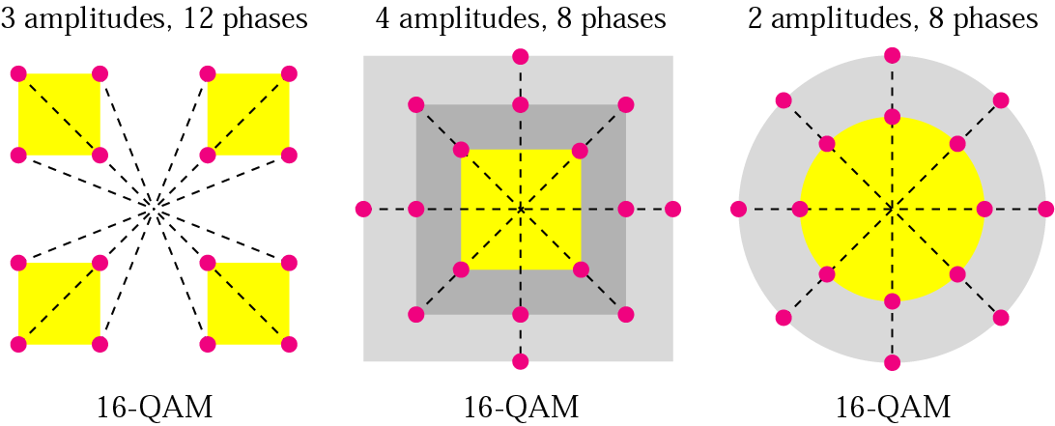
16-QAM Constellation
第一个16-QAM采用3种振幅和12个相位，因相位数与振幅数的比率更高，而具有最好的抗噪声性能，是ITU-T的推荐配置；
第二个16-QAM采用4种振幅和8个相位，是ISO的推荐配置，通过使用所有可能变化的一半，增大变化之间的可检测距离，从而保证了更好的信号可读性。
QAM的优点：对噪声更低的敏感性。

Slide 76
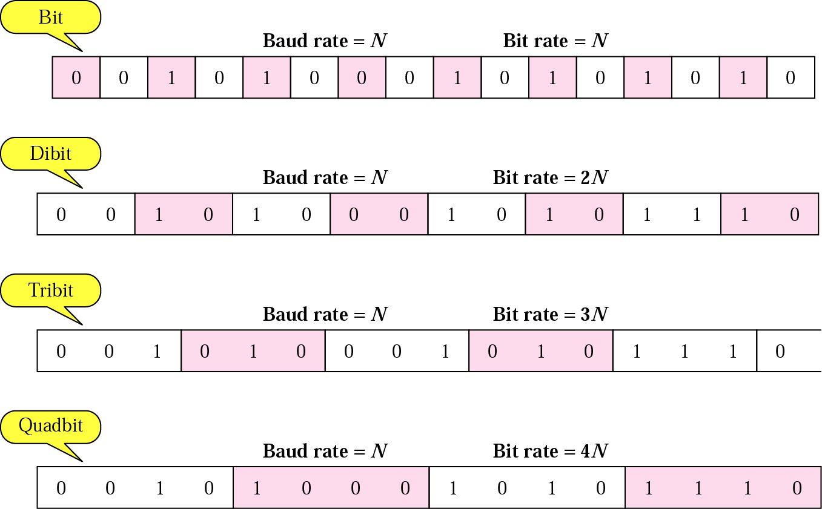
Bit Rate and Baud Rate

Slide 77
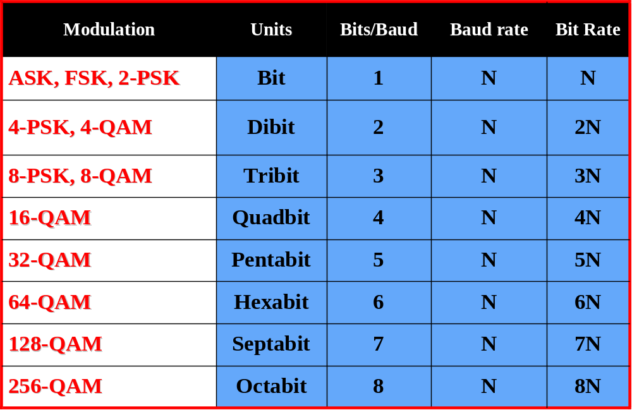
Bit and Baud rate comparison

Slide 78
Example 18
A constellation diagram consists of eight equally spaced points on a circle. If the bit rate is 4800 bps, what is the baud rate?
Solution
The constellation indicates 8-PSK with the points 45 degrees apart. Since 2³ = 8, 3 bits are transmitted with each signal unit. Therefore, the baud rate is
4800 / 3 = 1600 baud

Slide 79
Example 19
Compute the bit rate for a 1000-baud 16-QAM signal.
Solution
A 16-QAM signal has 4 bits per signal unit since
log₂16 = 4.
Thus,
(1000)(4) = 4000 bps

Slide 80
Example 20
Compute the baud rate for a 72,000-bps 64-QAM signal.
Solution
A 64-QAM signal has 6 bits per signal unit since
log₂ 64 = 6.
Thus,
72000 / 6 = 12,000 baud

Slide 81
Analog – analog conversion
Amplitude Modulation (AM)
Frequency Modulation (FM)
Phase Modulation (PM)

Slide 82
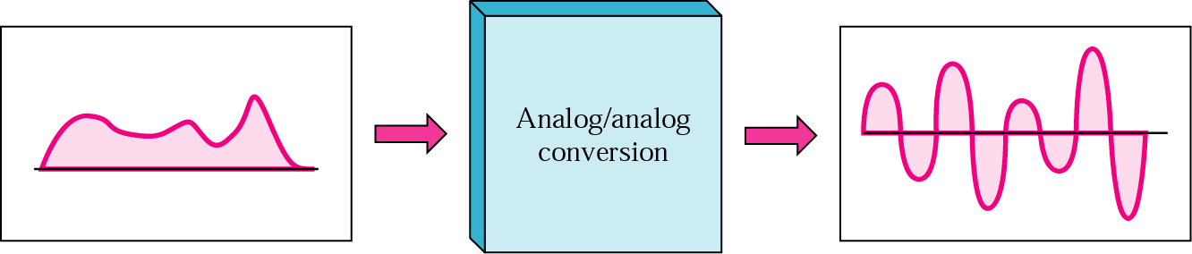
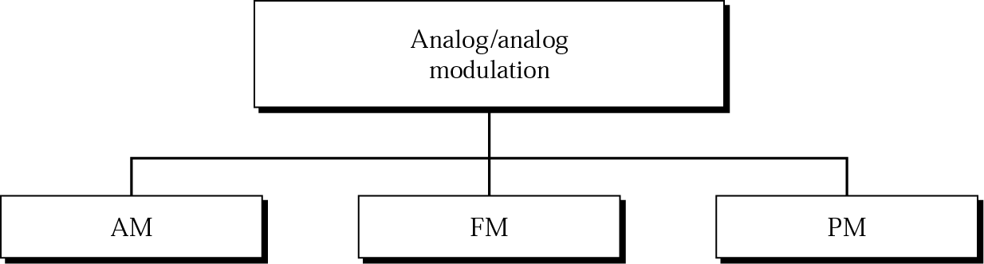
Analog to Analog Modulation
模拟－模拟调制是用模拟信号来表示模拟信息的一种技术。E.g.无线电波

Slide 83
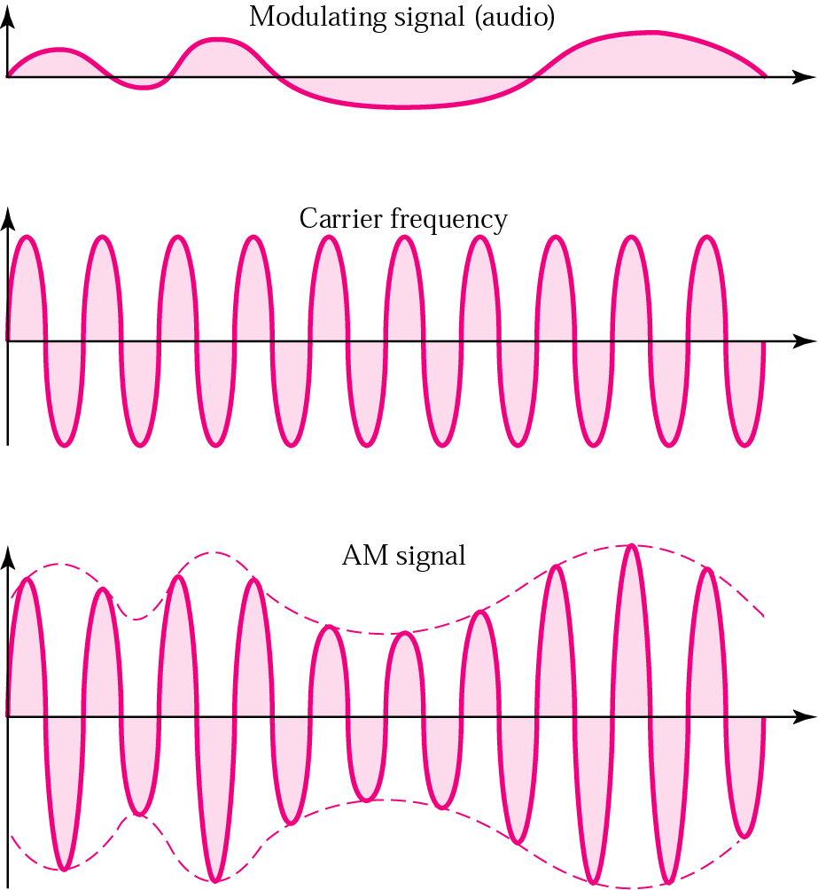
Amplitude Modulation
调幅AM：对载波信号进行调制使其振幅根据调制信号振幅的改变而变化。
工作原理：调制信号变成了载波信号的一个包络线。

Slide 84
Note:
The total bandwidth required for AM can be determined from the bandwidth of the audio signal:
BW_{t} = 2 × BW_{m}

Slide 85
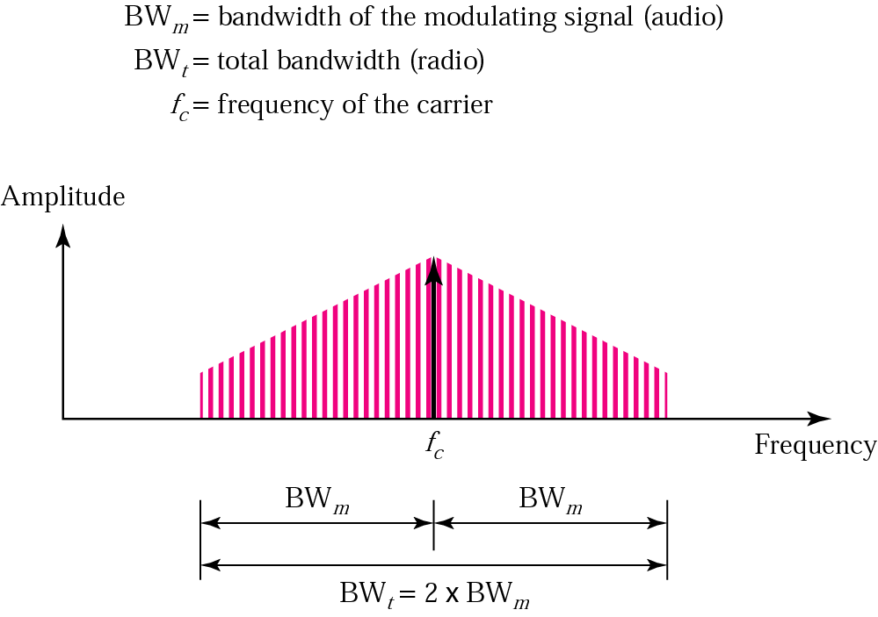
AM Bandwidth

Slide 86
Note:
The bandwidth of a audio frequency signal is usually 5 KHz. Therefore, an AM station needs at least a bandwidth of 10 KHz.
In fact, the FCC allocates 10 KHz bandwidth to each AM station.

Slide 87
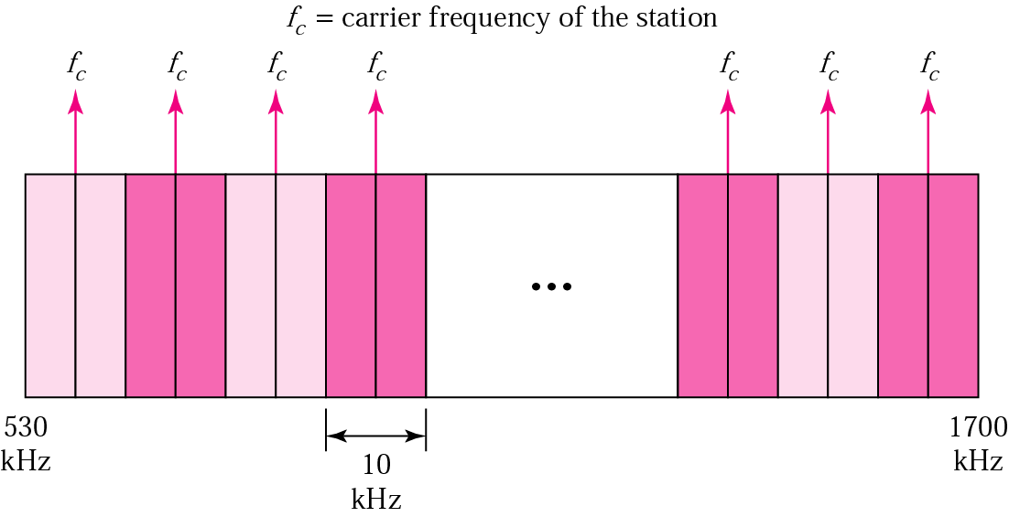
AM Band Allocation
调幅电台可以采用在530－1700KHz之间的任何频率作为载波频率。
但是每个电台的载波频率必须和其它电台的载波频率间隔至少10KHz（一个调幅带宽）来防止干扰。

Slide 88
Example 21
We have an audio signal with a bandwidth of 4 KHz. What is the bandwidth needed if we modulate the signal using AM? Ignore FCC regulations.
Solution
An AM signal requires twice the bandwidth of the original signal:
BW = 2 x 4 KHz = 8 KHz

Slide 89
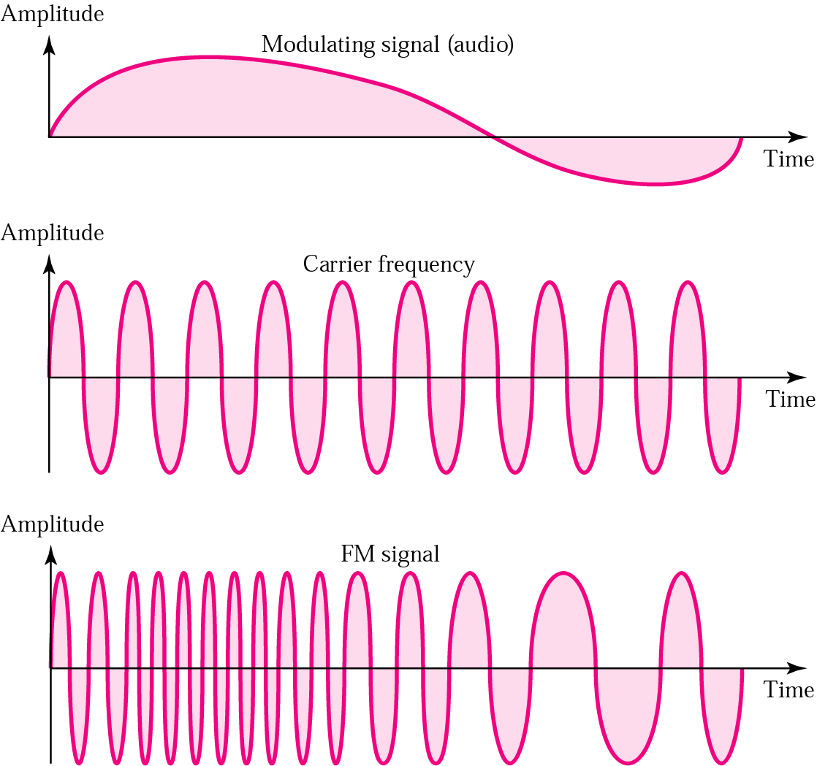
Frequency Modulation
调频FM：对载波信号进行调制使其频率随调制信号振幅的改变而变化。

Slide 90
Note:
The total bandwidth required for FM can be determined from the bandwidth of the audio signal:
BW_{t} = 10 × BW_{m}

Slide 91
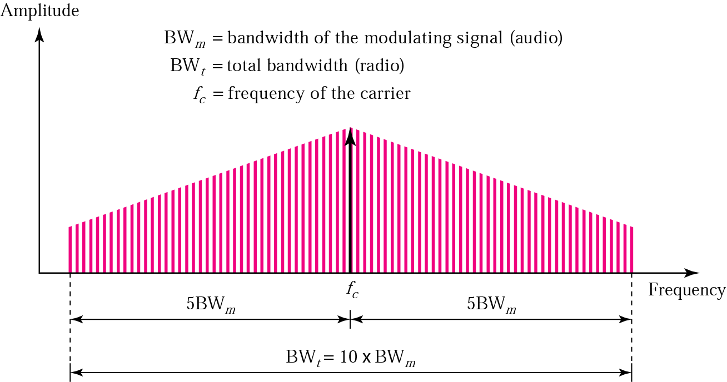
FM Bandwidth

Slide 92
Note:
The bandwidth of a stereo audio signal is usually 15 KHz. Therefore, an FM station needs at least a bandwidth of 150 KHz.
The FCC requires the minimum bandwidth to be at least 200 KHz (0.2 MHz).

Slide 93

FM Band Allocation
调频电台可以采用在88－108MHz之间的任何频率作为载波频率。
但是每个电台的载波频率必须和其它电台的载波频率间隔至少200KHz（一个调幅带宽）来防止干扰；并且为了提供更强的专用性，FCC规定在一个给定区域，只能交替使用分配的波段。

Slide 94
Example 22
We have an audio signal with a bandwidth of 4 MHz. What is the bandwidth needed if we modulate the signal using FM? Ignore FCC regulations.
Solution
An FM signal requires 10 times the bandwidth of the original signal:
BW = 10 x 4 MHz = 40 MHz

